Slide 1
LeetCode 全系列速通 (五)
13. 字典树 (Trie)
14. 堆 (Heap)
15. 并查集 (Union Find)
你们的好朋友Eddie

Slide 2
我们希望在60题之内做一个可以在1到2小时可以覆盖的知识点，可以用来快速复习
算法 27题
1. bianry search 3题，一道正常binary, 一道用来猜答案，lis
2. pointer 2题，2 sum, 3sum
3. sliding window 2题
4. bfs + dfs 3 + 3 = 6 题
5. backtracking 2题， subset, permutation
6. sort merge sort/quick sort/bucket sort 3题
7. monotonic stack 2题
8. monotonic queue 2题
9. 扫描线 2题
10. divide and conquer 2题
11. Bit manipulation 2题
12. prefix sum 1题
数据结构18题
13. Trie 2题
14. heap 2题
15. union find 1题
16. list 翻转+合并+找环+删除+结构转换 5题
17. comparator 1题
18. LRU 1题
19. tree 遍历+结构转换+LCA+BST+Iterator 6题
图 6题
bfs, dfs, topological, dijikstra, union find, mst
动态规划 9题
1d, 2d, backpack1,2, dfs+memo, LIS, LCS, LPS, range DP (覆盖坐标类，背包类，区间类，字符串单双序列) 9

Slide 3
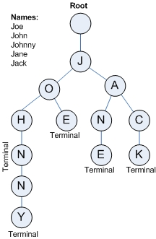
What is a Trie? pronounce it /ˈtraɪ/ (as "try"), in an attempt to distinguish it verbally from "tree".
someone read like tree, from retrieval is also correct
Trie树，又叫字典树、前缀树（Prefix Tree）、单词查找树 或 键树，是一种多叉树结构。如下图：
Trie is like a N-array Tree.
字典树的性质
根节点（Root）不包含字符，除根节点外的每一个节点都仅包含一个字符；
从根节点到某一节点路径上所经过的字符连接起来，即为该节点对应的字符串；
任意节点的所有子节点所包含的字符都不相同；

Slide 4
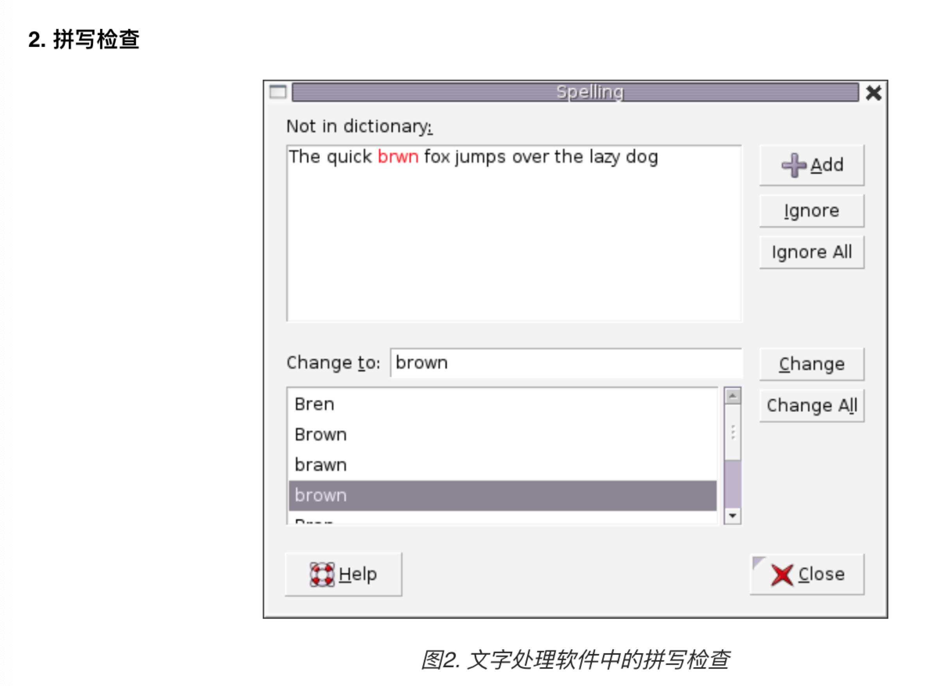
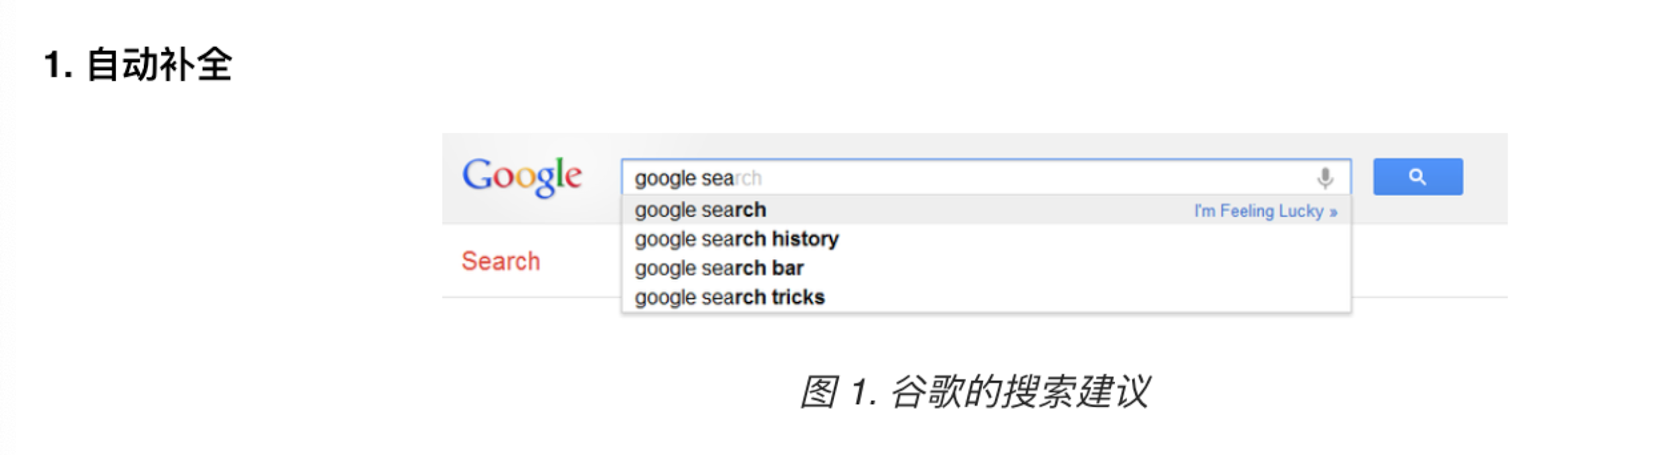
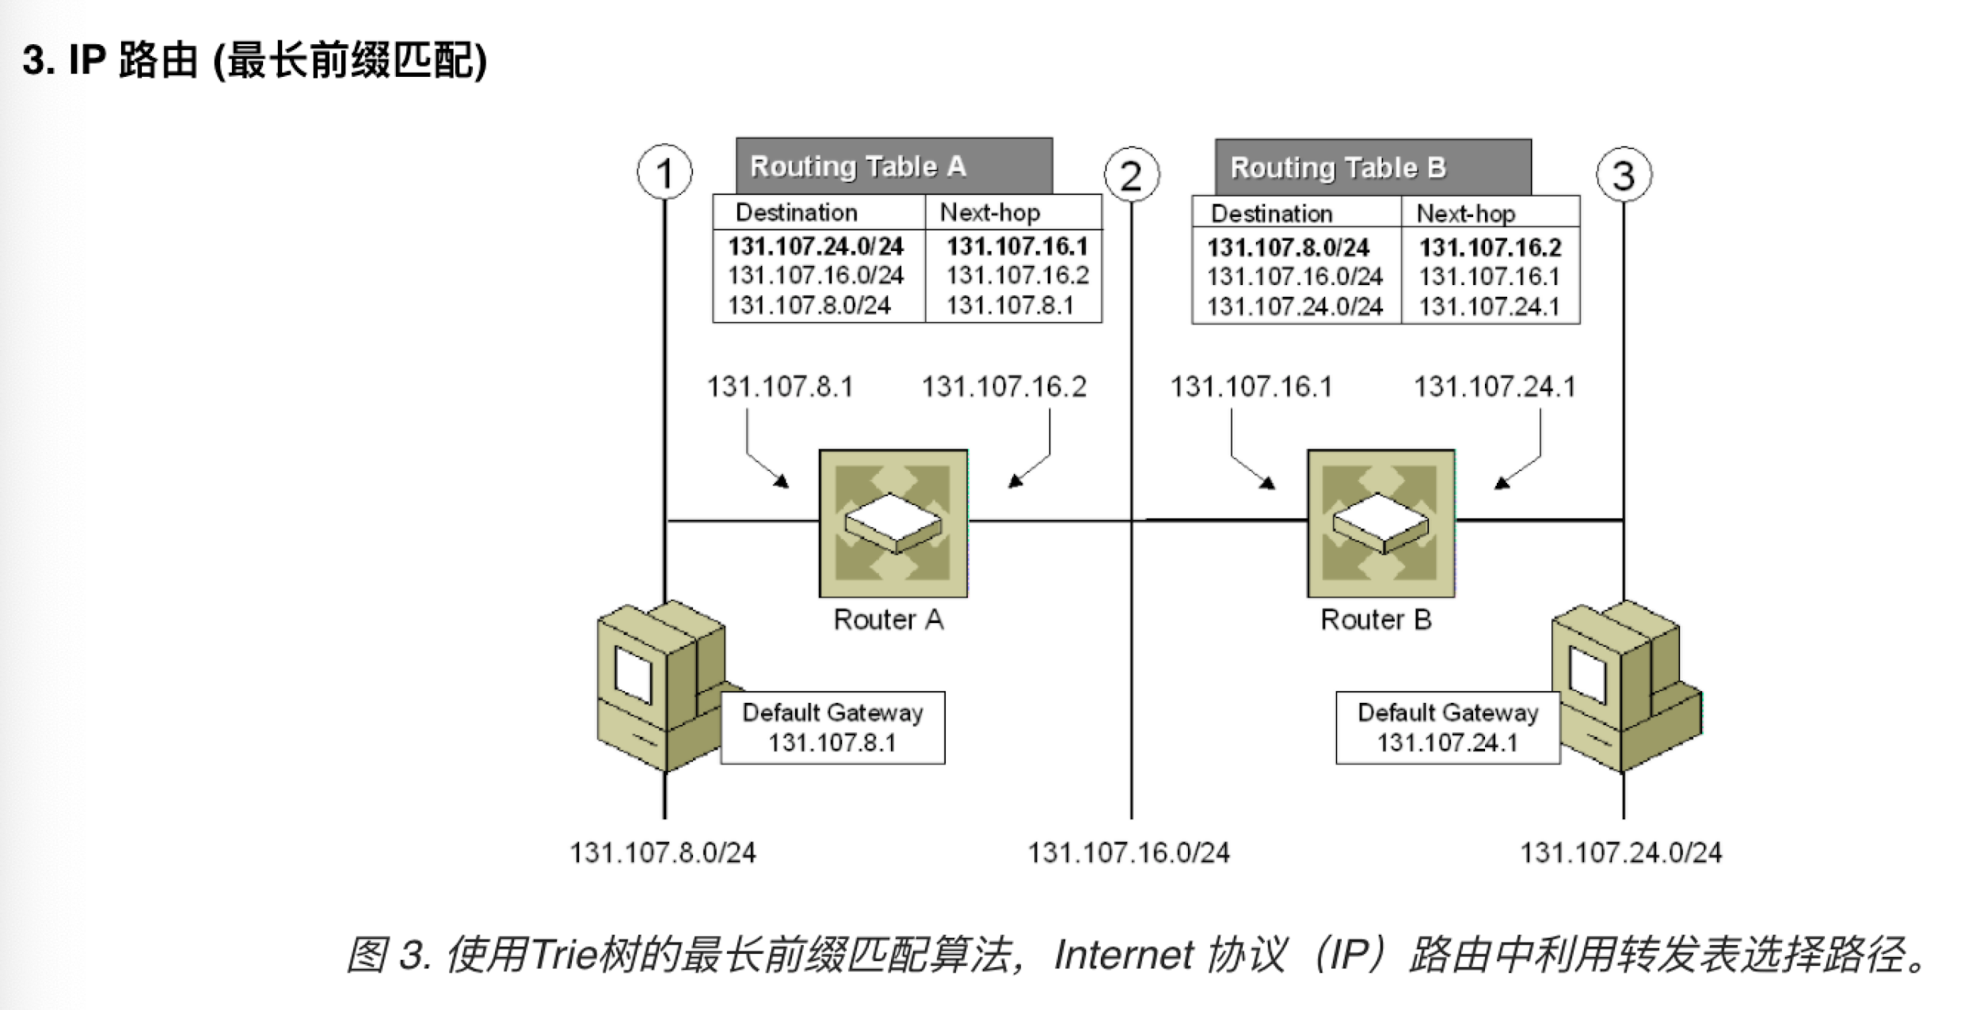
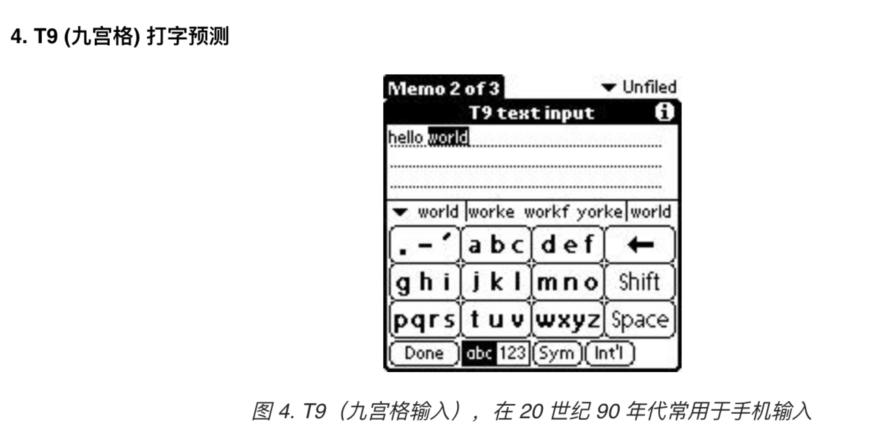
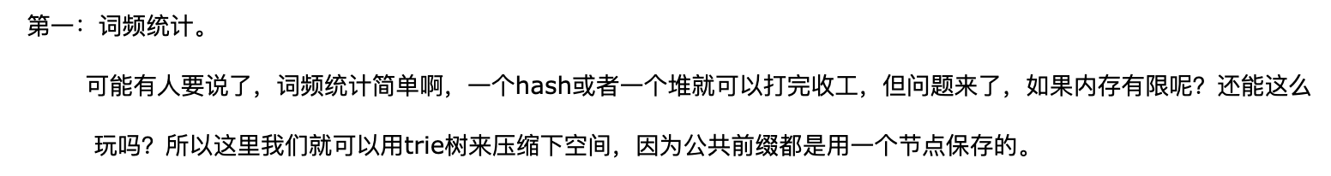
Use cases

Slide 5
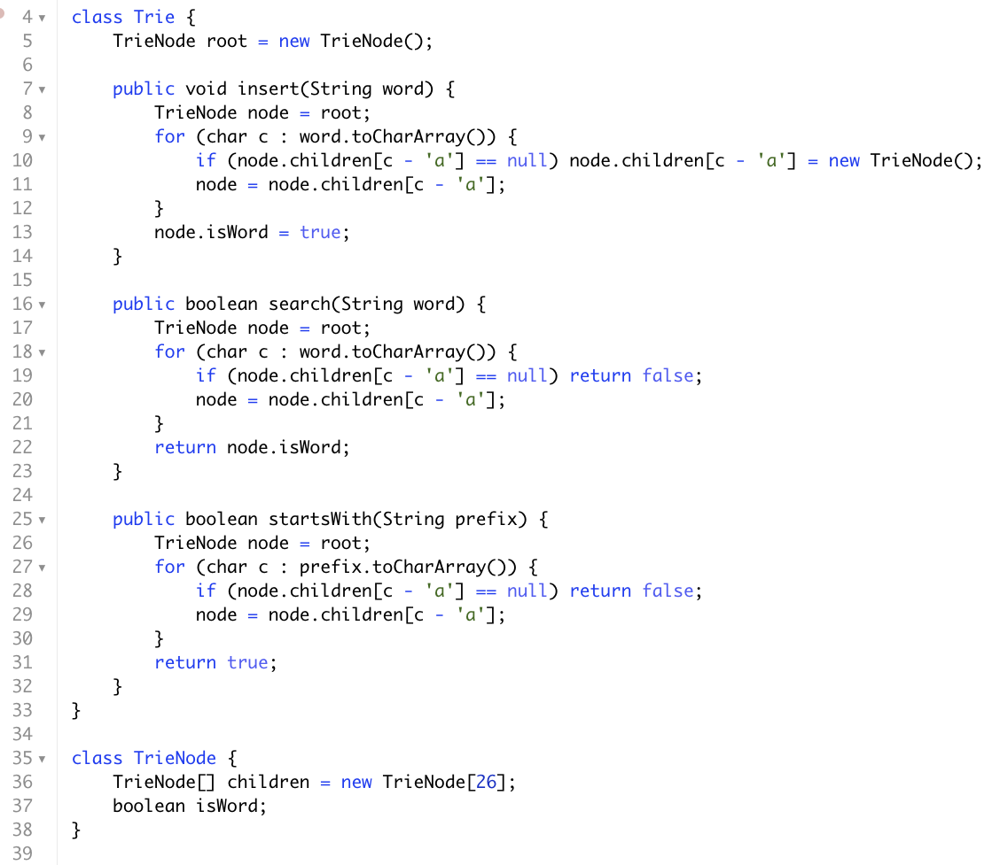
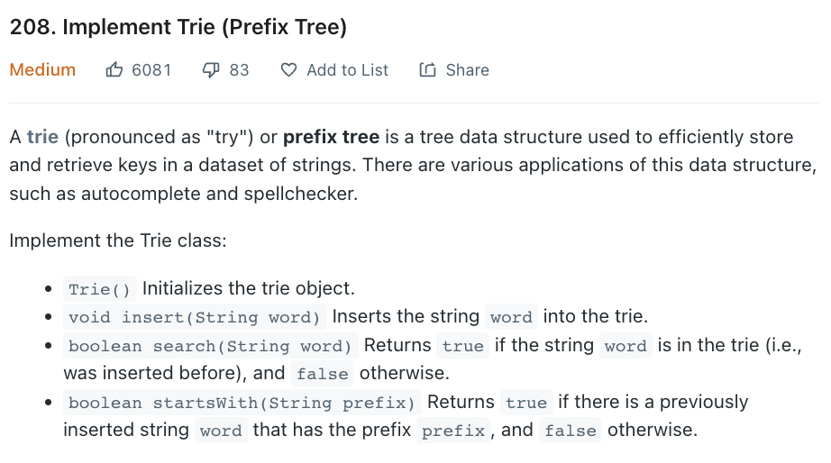
模板
常用method
addWord(String word)
search(String word)
searchPrefix(String prefix)

Slide 6
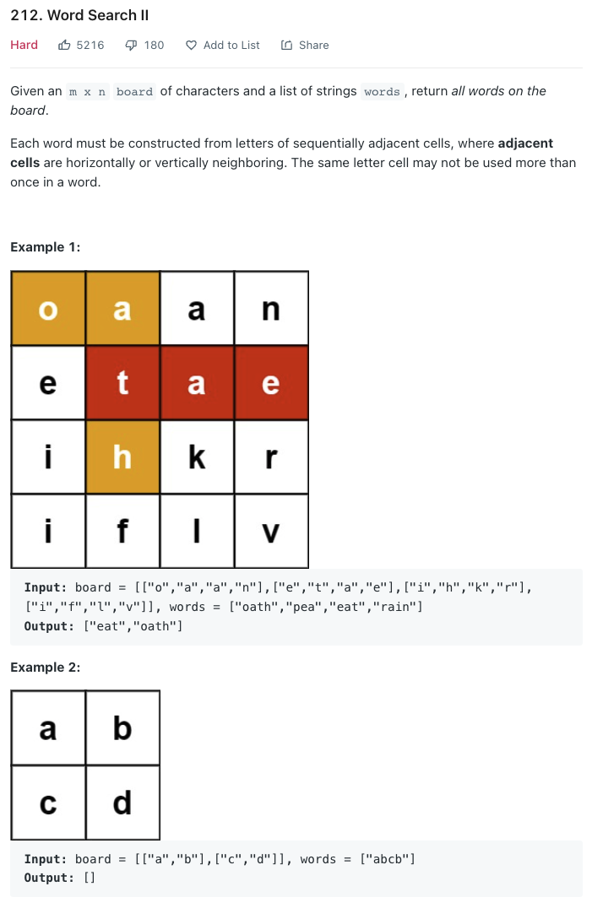
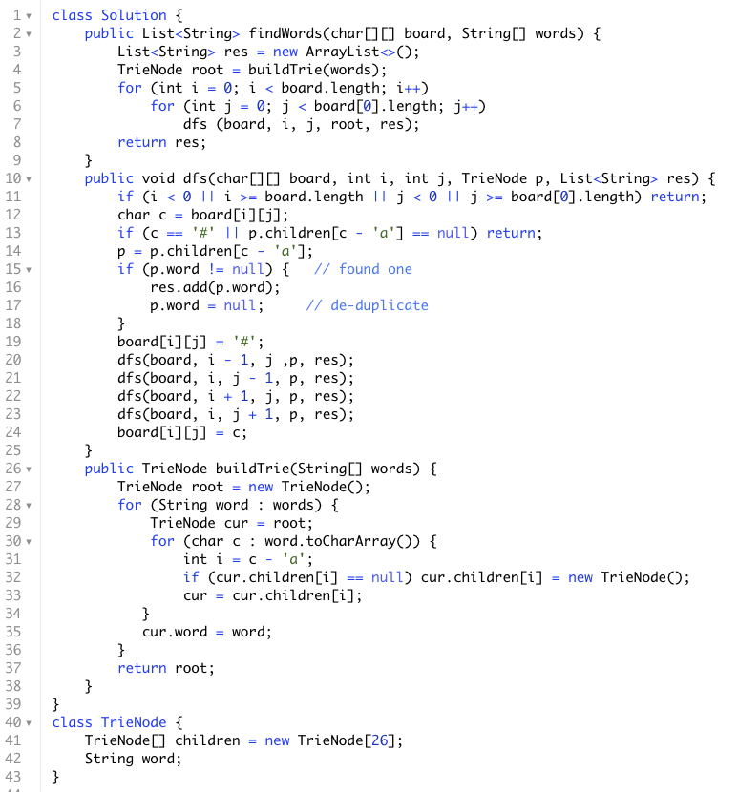
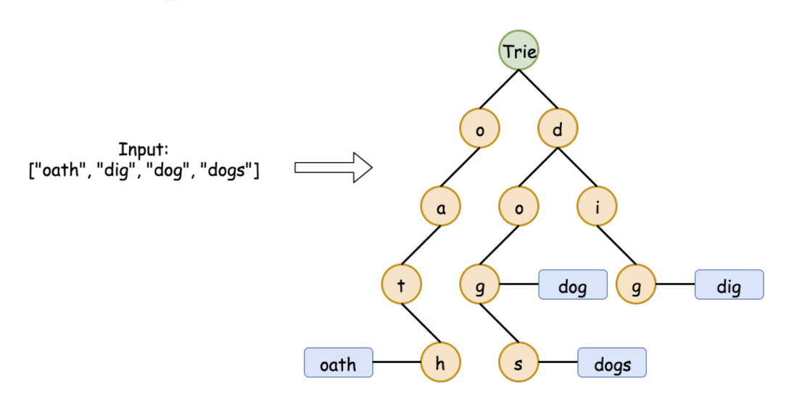
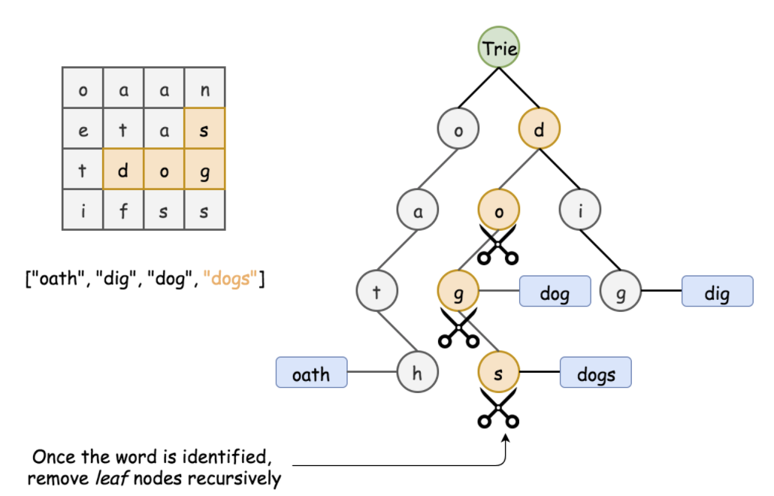
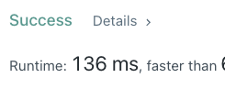
使用ending word模板

Slide 7
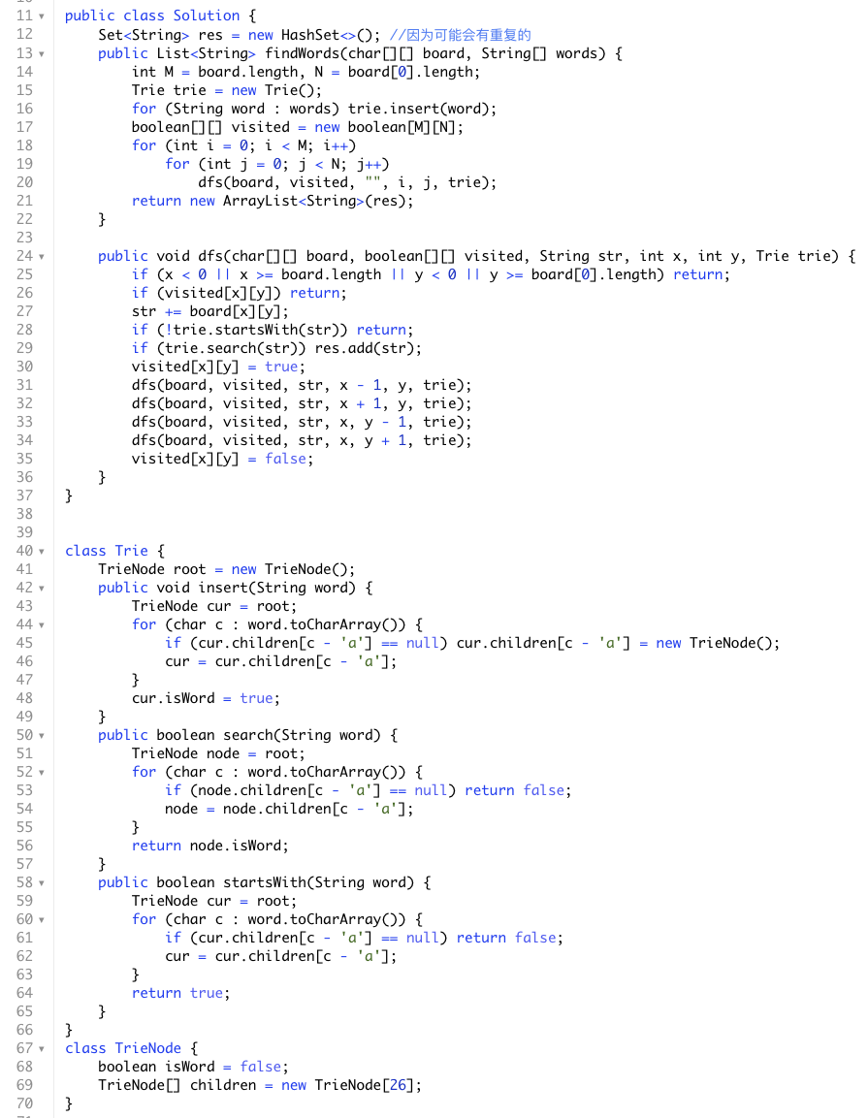
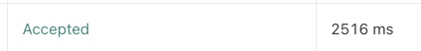
或者使用boolean模板
因为在过程中传了str下去，所以有点变慢了

Slide 8
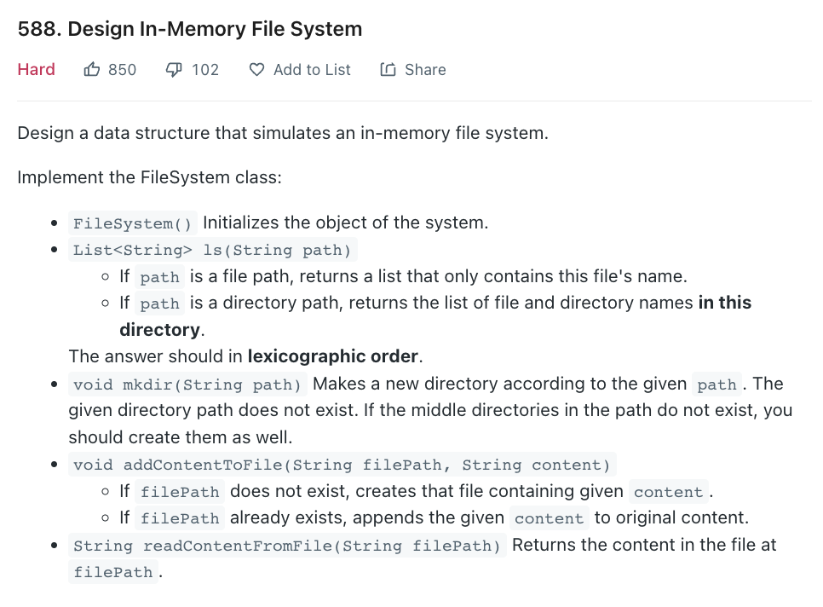
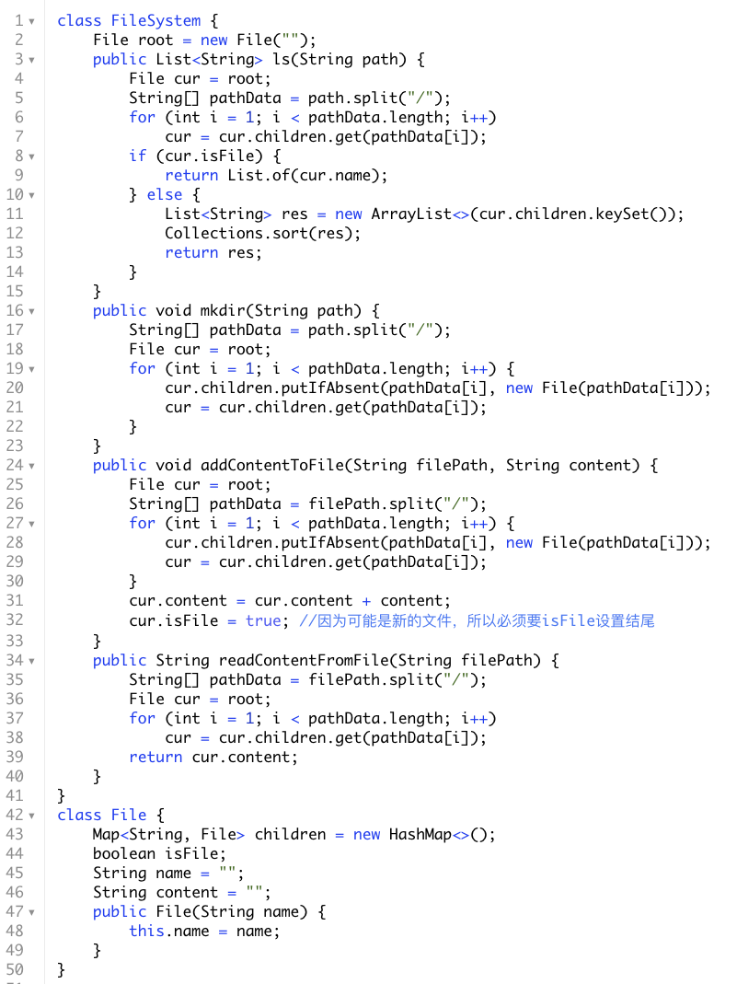
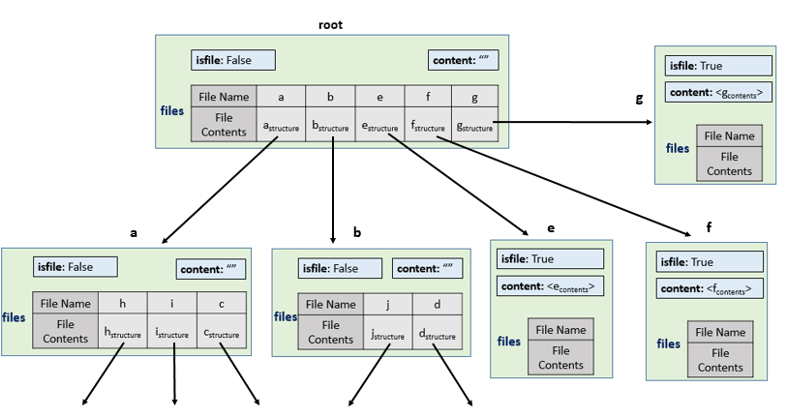
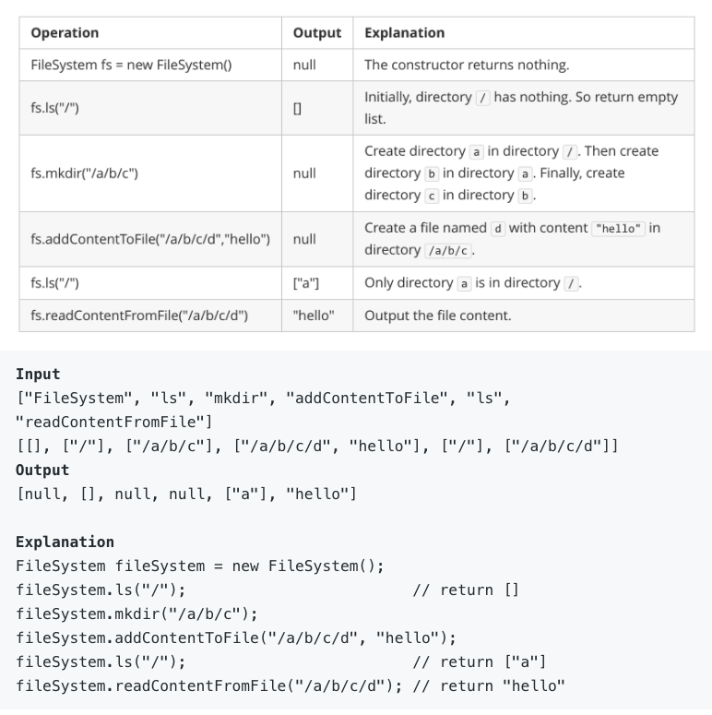
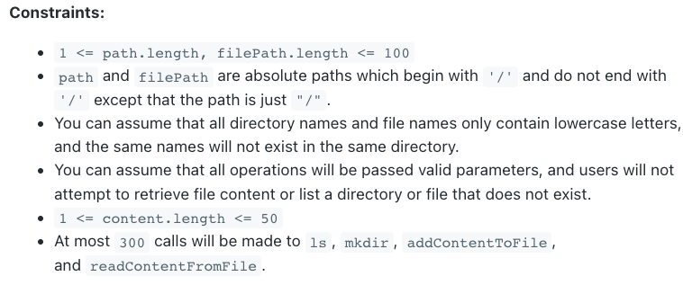
name
name
name
name
name
name

Slide 9
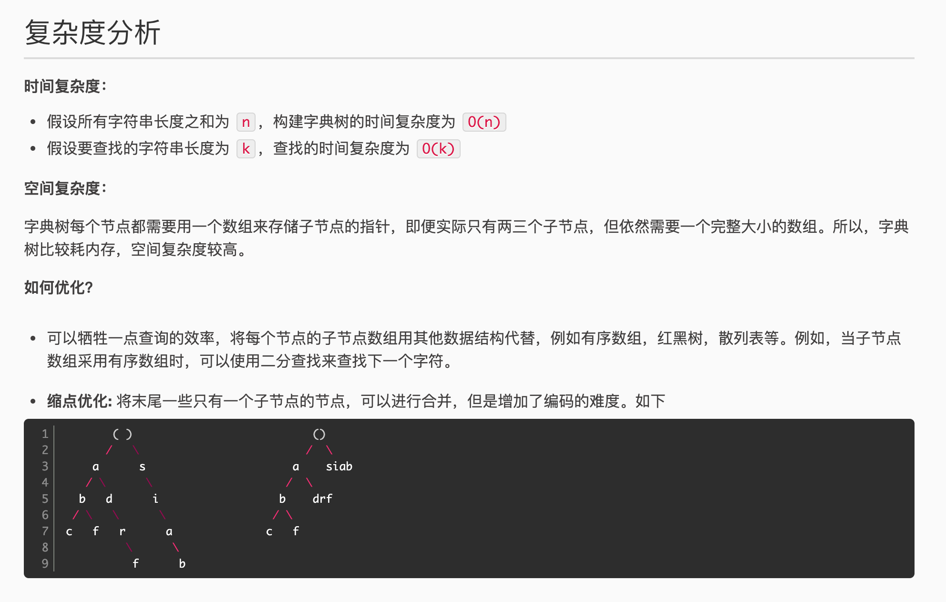
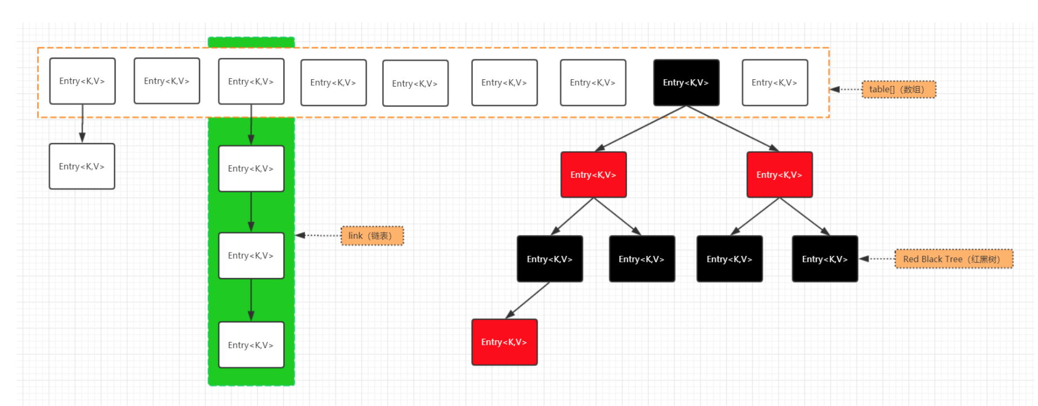
Double Array Trie - 张朝阳- 博客园
这里用hashmap是省空间但是”变慢”了一点点
HashMap
初始化16size, resize 0.75load factor, 链表8size, 大于则切换红黑树

Slide 10
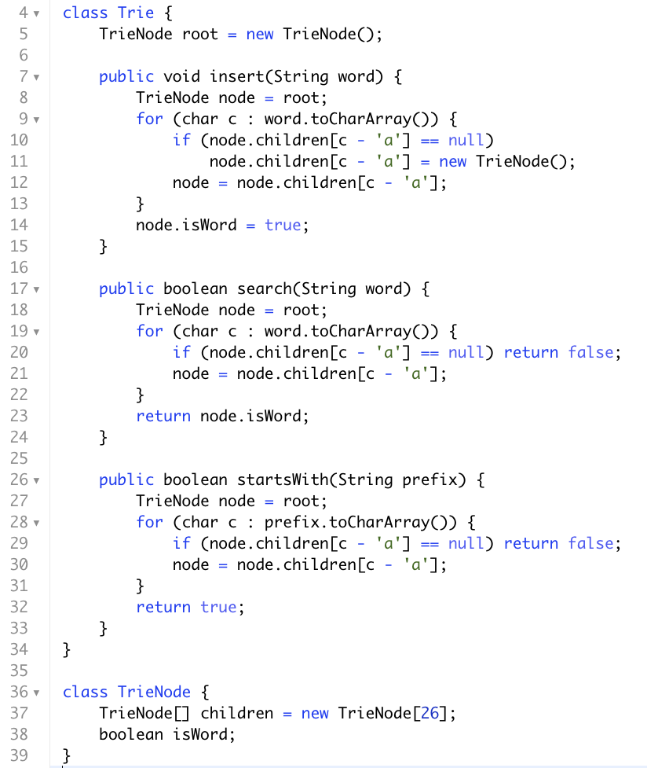
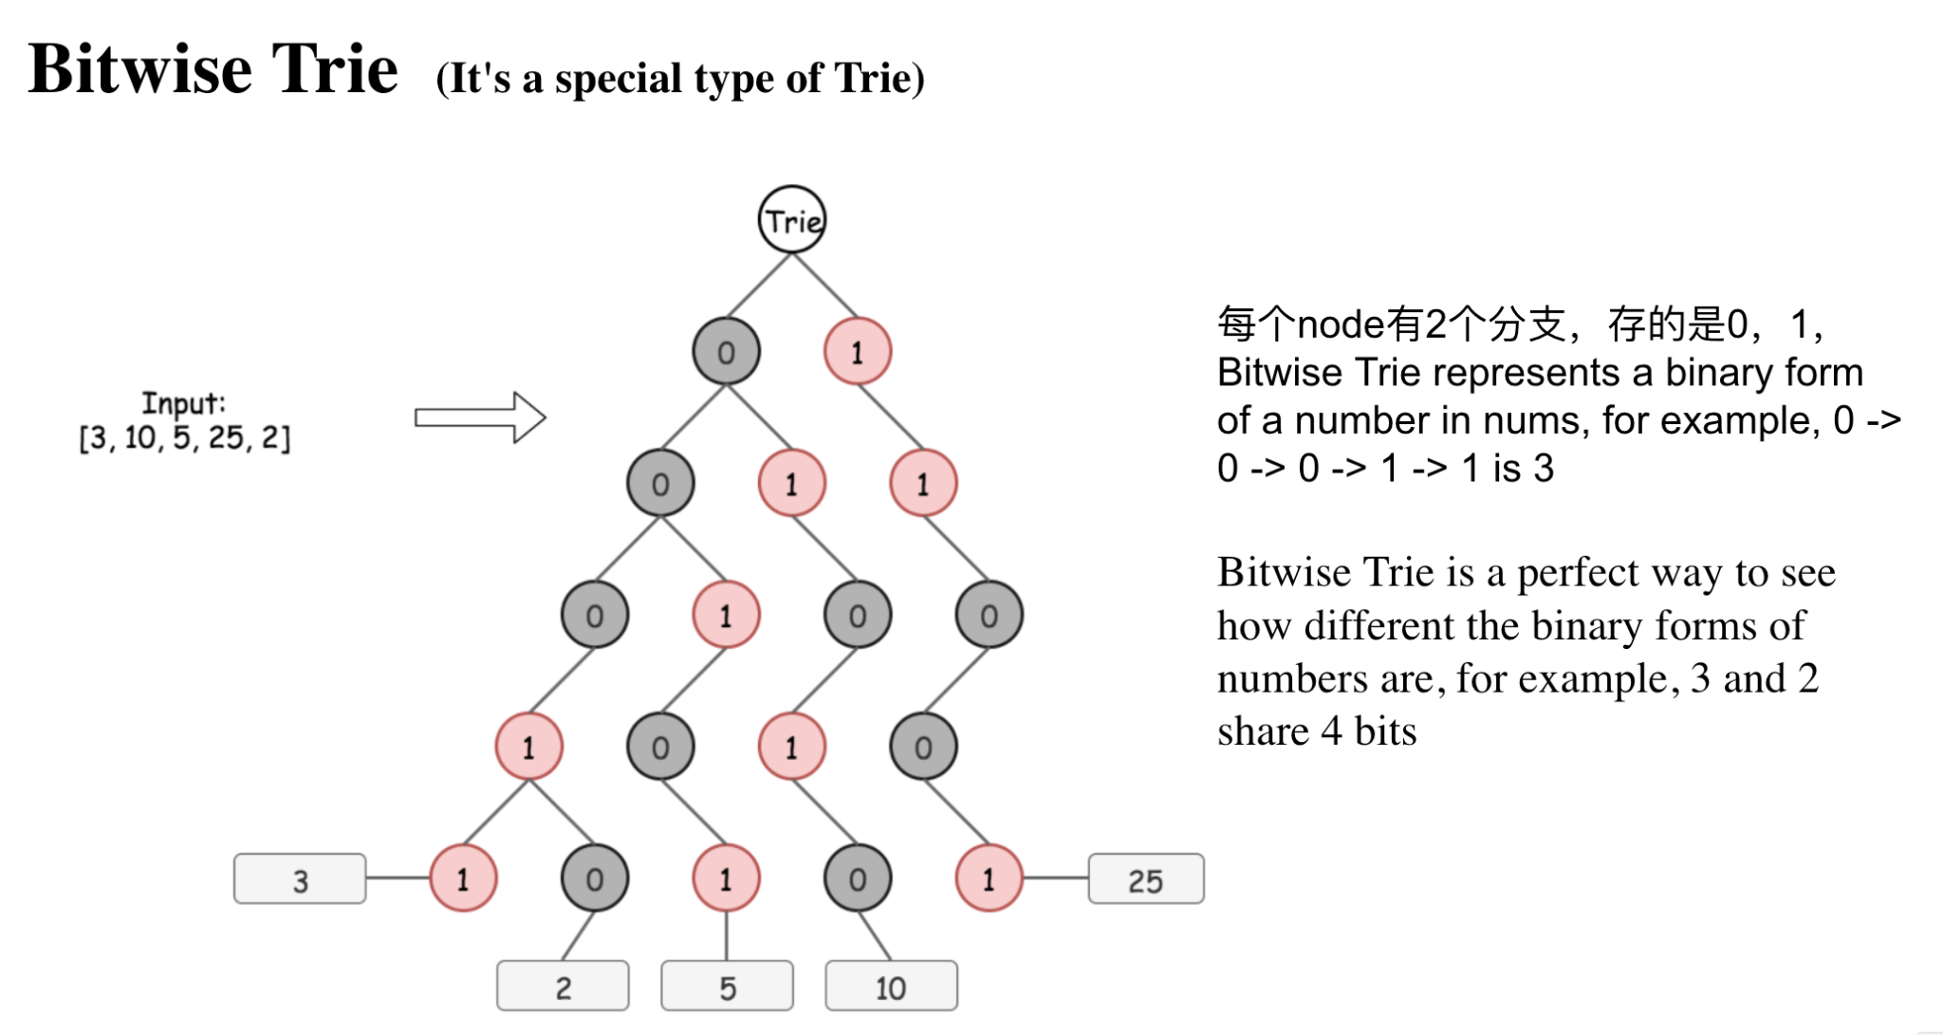
Summary
高频，常考，必会，电面经常！
可以普通字典树，或者bitwise字典树
时间复杂度 建立Trie O(nk), n是单词数量，k是单词长度 时间复杂度 搜索O(k), k是单词长度
空间优化可以用map代替array，缩点优化等
可以思考一下如果删除怎么写
常用method
addWord(String word)
search(String word)
searchPrefix(String prefix)
基础数据结构(一) -- Trie

Slide 11
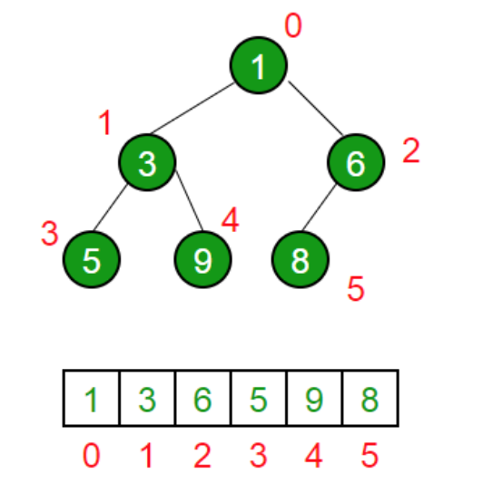
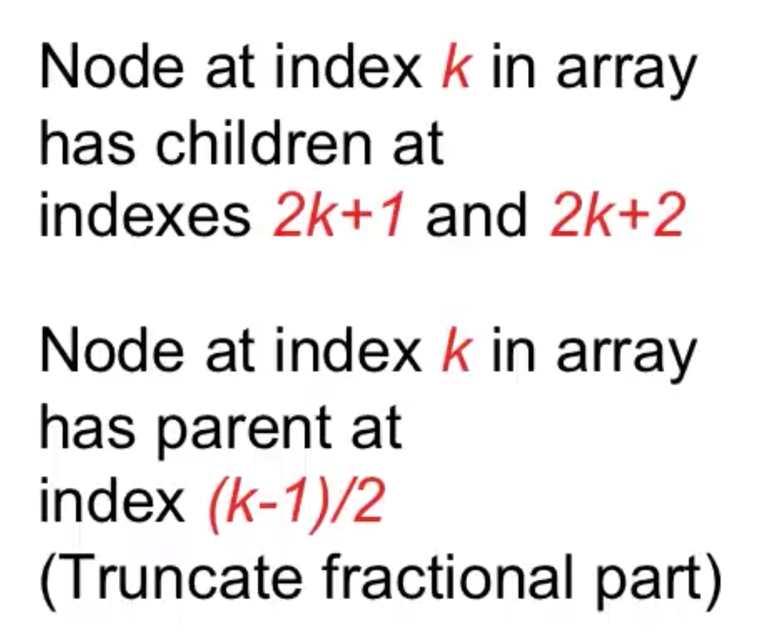
Heap Definition
(Binary) Heap is a special case of balanced binary tree data structure where the root-node key is compared with its children and arranged accordingly.
Min-Heap − Where the value of the root node is less than or equal to either of its children.
Max-Heap − Where the value of the root node is greater than or equal to either of its children.
This is important ->

Slide 12
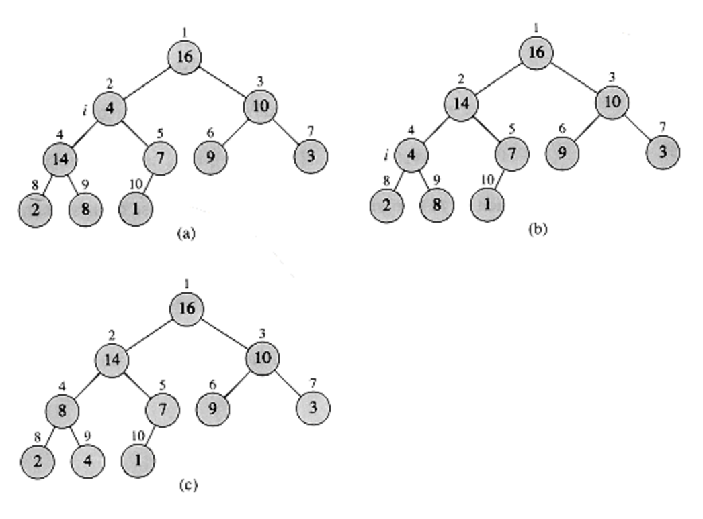
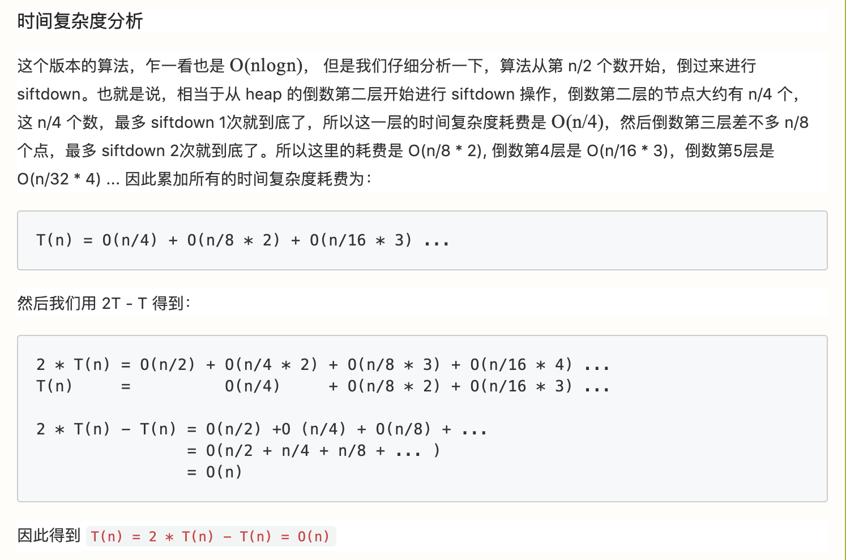
Heapify Definition
HEAPIFY is an important subroutine for manipulating heaps. Its inputs are an array A and an index i into the array. When HEAPIFY is called, it is assumed that the binary trees rooted at LEFT(i) and RIGHT(i) are heaps, but that A[i] may be smaller than its children, thus violating the heap property (7.1). The function of HEAPIFY is to let the value at A[i] "float down" in the heap so that the subtree rooted at index i becomes a heap.
Lecture 14: HeapSort Analysis and Partitioning

Slide 13
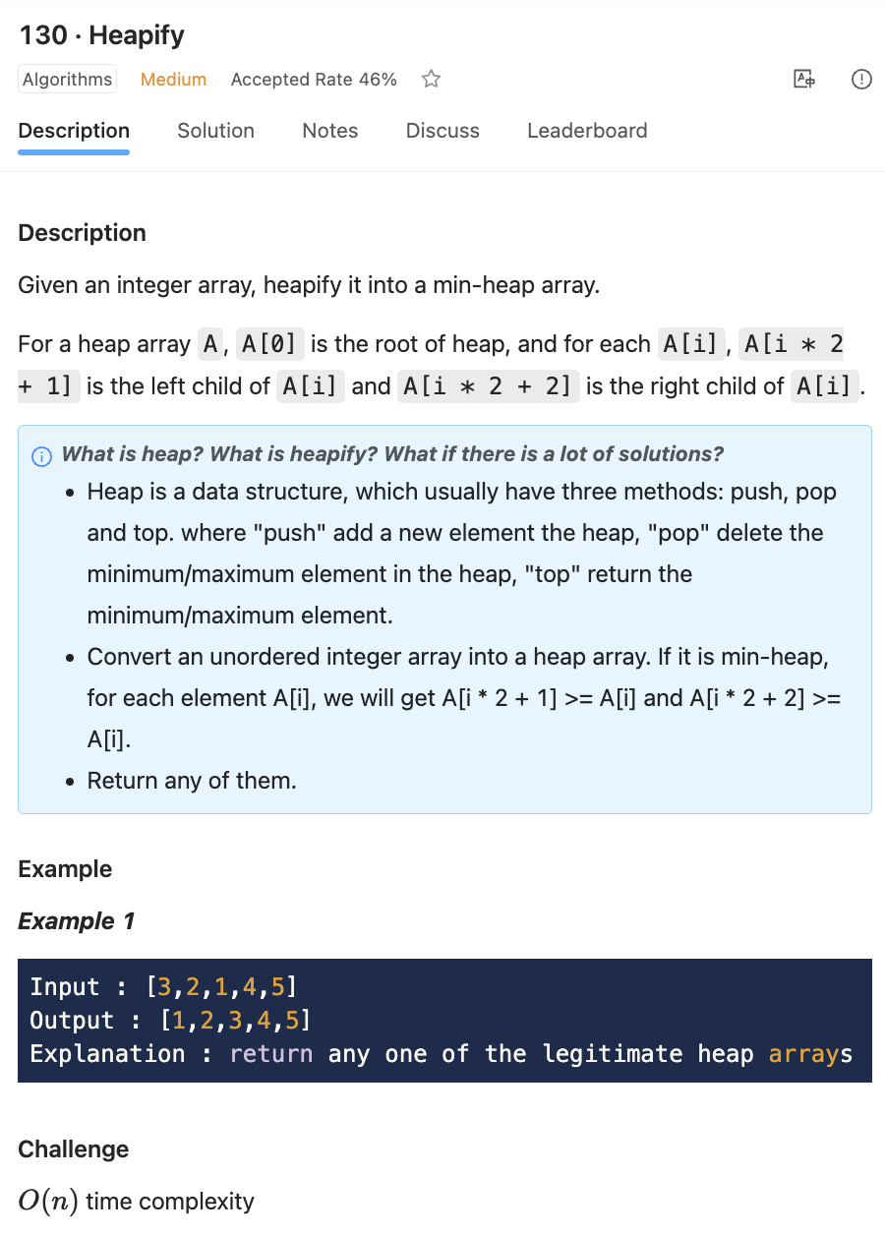
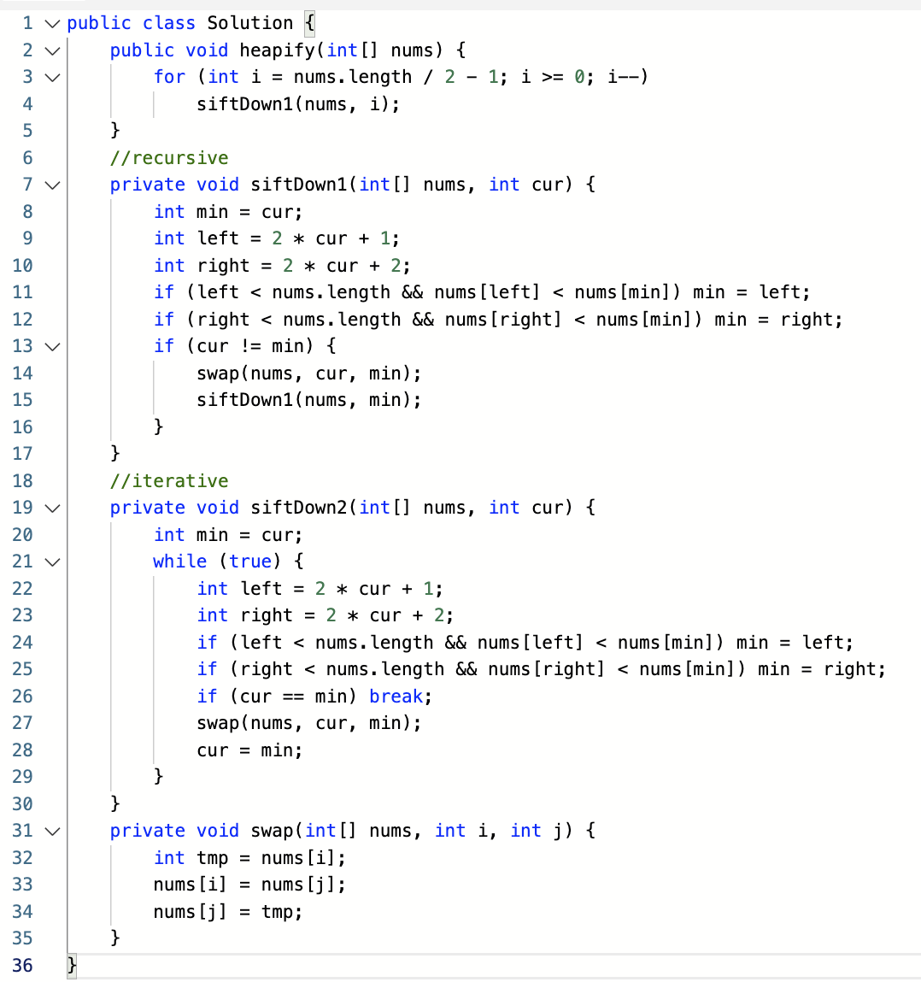

Slide 14
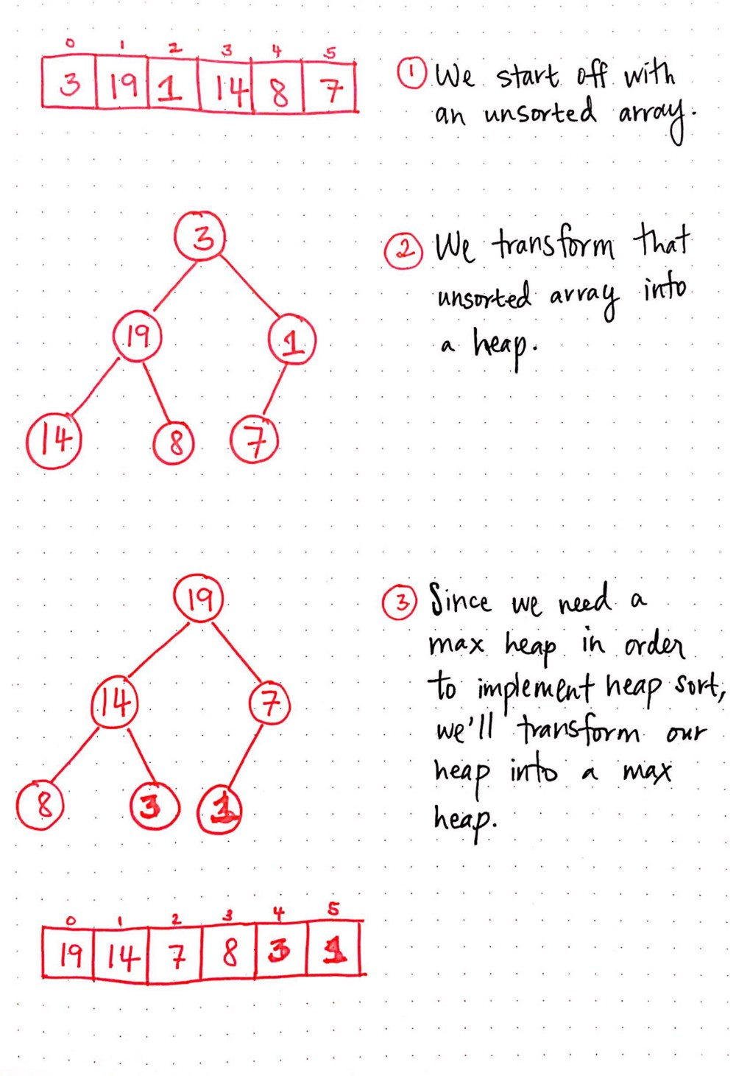
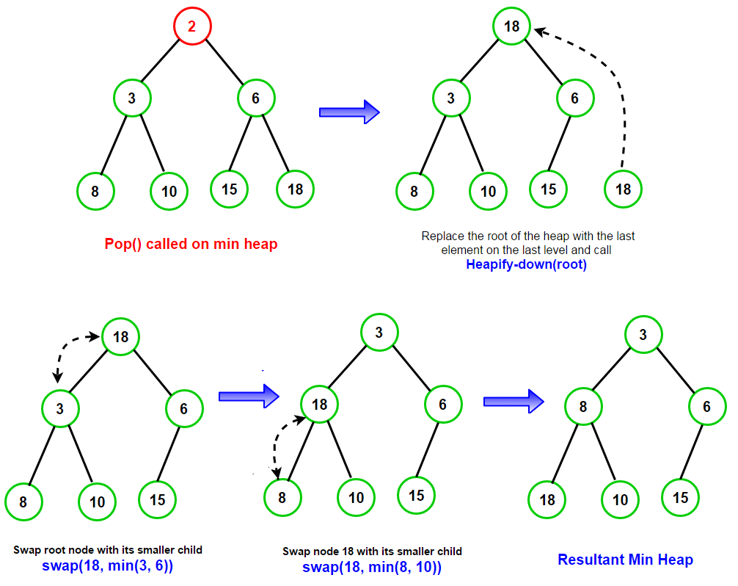

Slide 15
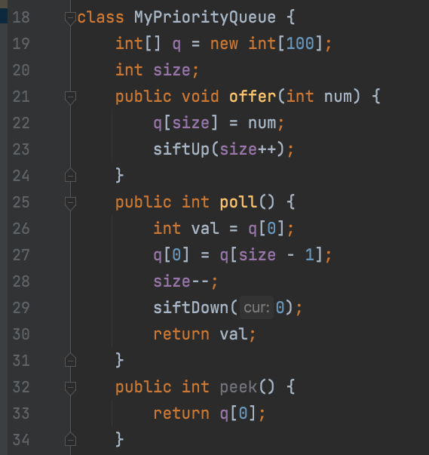
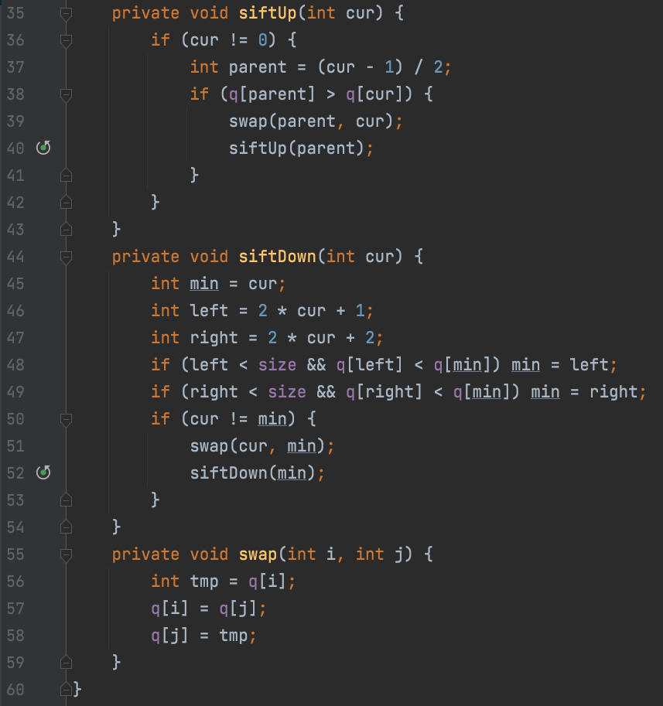
Let’s build an application using minHeap -- PriorityQueue
Method:
offer() : add number
poll() : get and remove the minimal number from pq
peek() : get the minimal number from pq

Slide 16
Heap Summary -- about time complexity
peekMax() or peekMin(), depends on which heap you implement, takes O(1)
add()/remove() a new number to heap would do logn times heapify, so time complexity is O(logn)
Delete random would cause O(n), because search O(n) + delete O(logn)
Build heap only takes O(n), we are doing heapify only for half of the element
O(n)的证明， 需要O(0.875n) Lecture 14: HeapSort Analysis and Partitioning

Slide 17
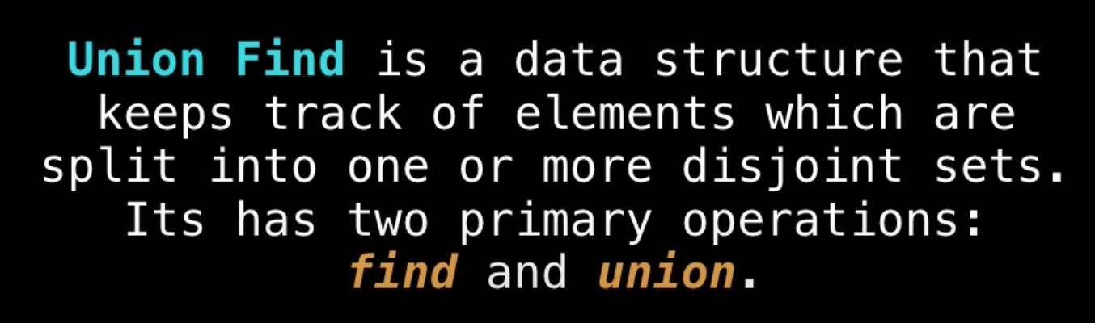
15. 动态连接（Dynamic connectivity）的问题, 什么是Union Find？
并查集 是一种树形的数据结构，用于处理不交集的合并(union)及查询(find)问题。
Find：确定元素属于哪一个子集。它可以被用来确定两个元素是否属于同一子集。
Union：将两个子集合并成同一个集合。

Slide 18
example
3 4 union(1, 5) 3
/ \ | / | \
1 2 5 1 2 4
\
Parent 3 3 3 4 4 3 3 3 3 4 5
Node 1 2 3 4 5 1 2 3 4 5

Slide 19
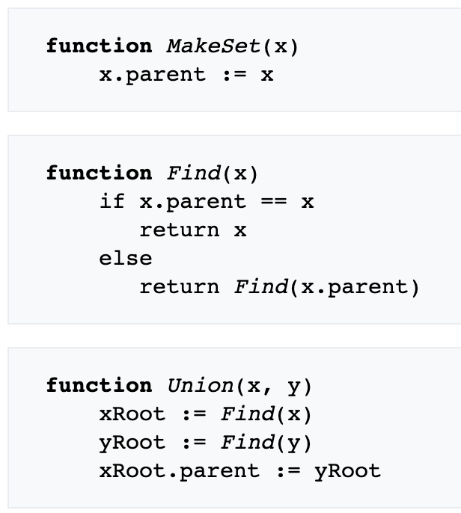
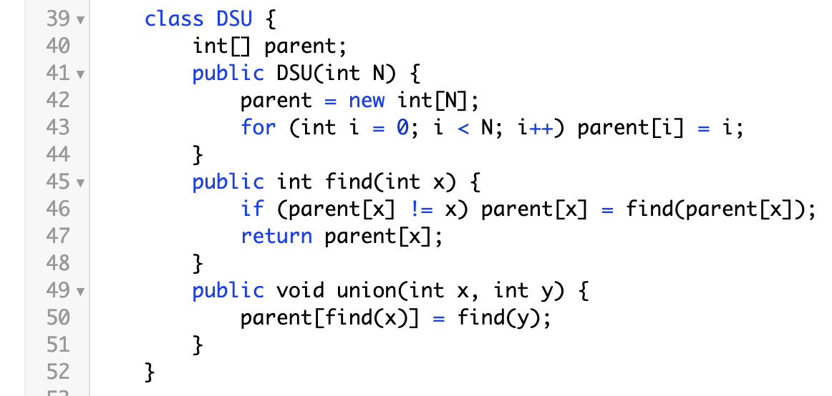
Basic implementation
with path compression

Slide 20
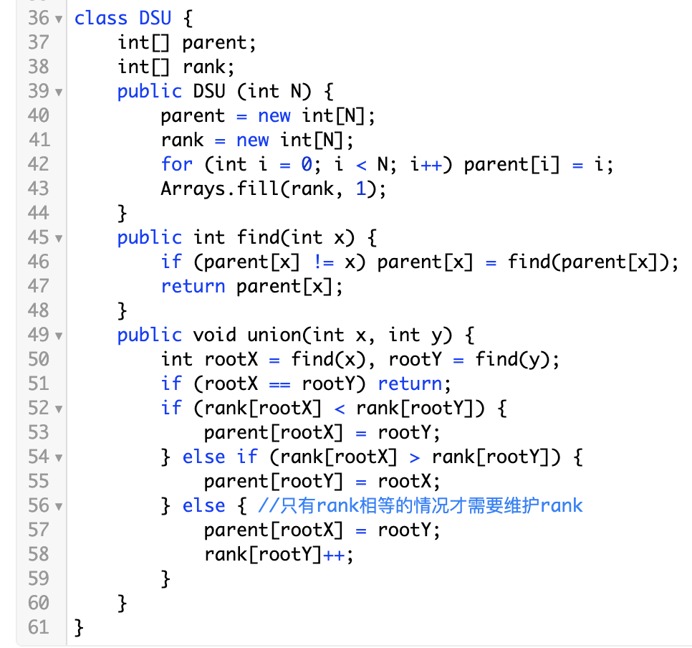
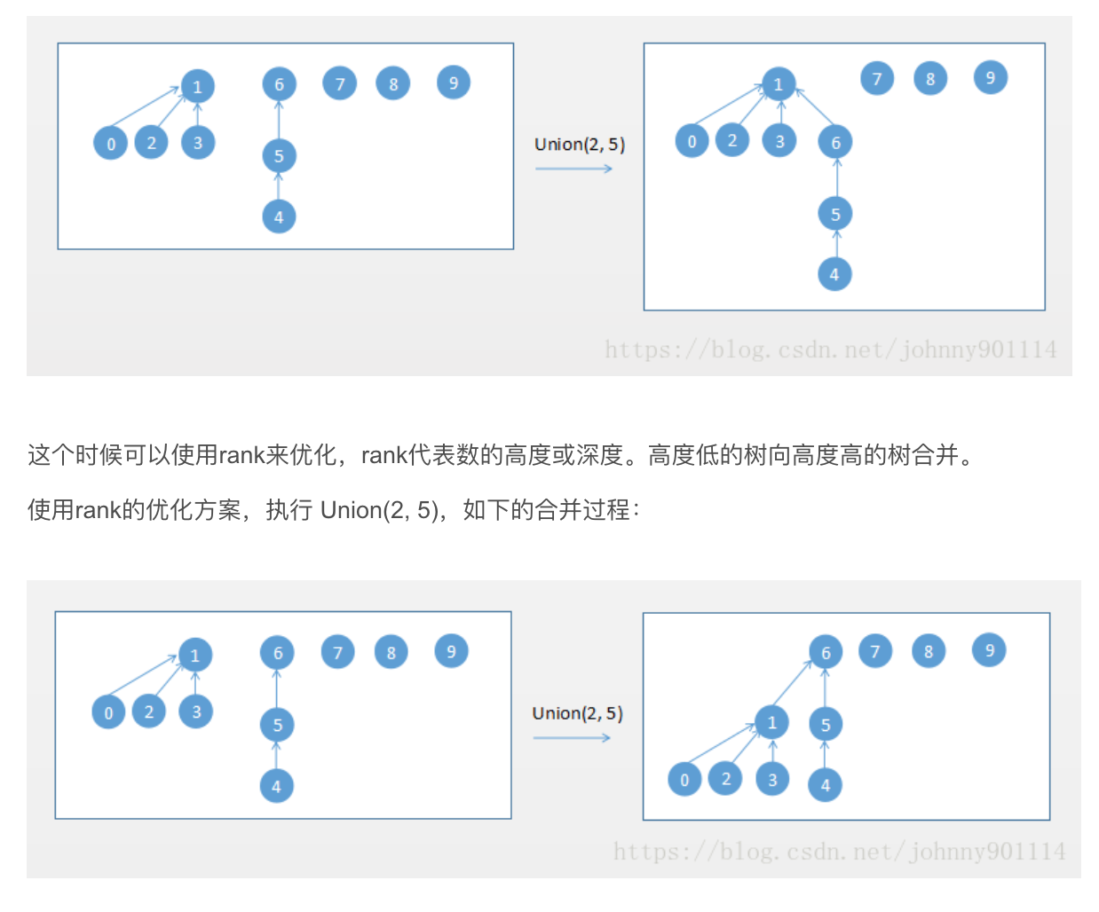
Improved with ranked

Slide 21
为什么path compression不更新rank?
Union by rank ensures that the maximum depth of the tree is log N, so it puts a worst case upper bound of O(log N) on every operation.
Path compression without any special union rules an upper bound of O(log N) on the amortized cost of each operation, but doesn't limit the worst case cost. (There might even be a tighter bound on the amortized cost, but O(log N) is the one I know how to prove)
Using both together, you get the O(log N) limit on the worst case and the amortized bound improves to 反阿克曼函数O(𝛼(N)), which is effectively constant. In this way the two optimizations are complementary.

Slide 22
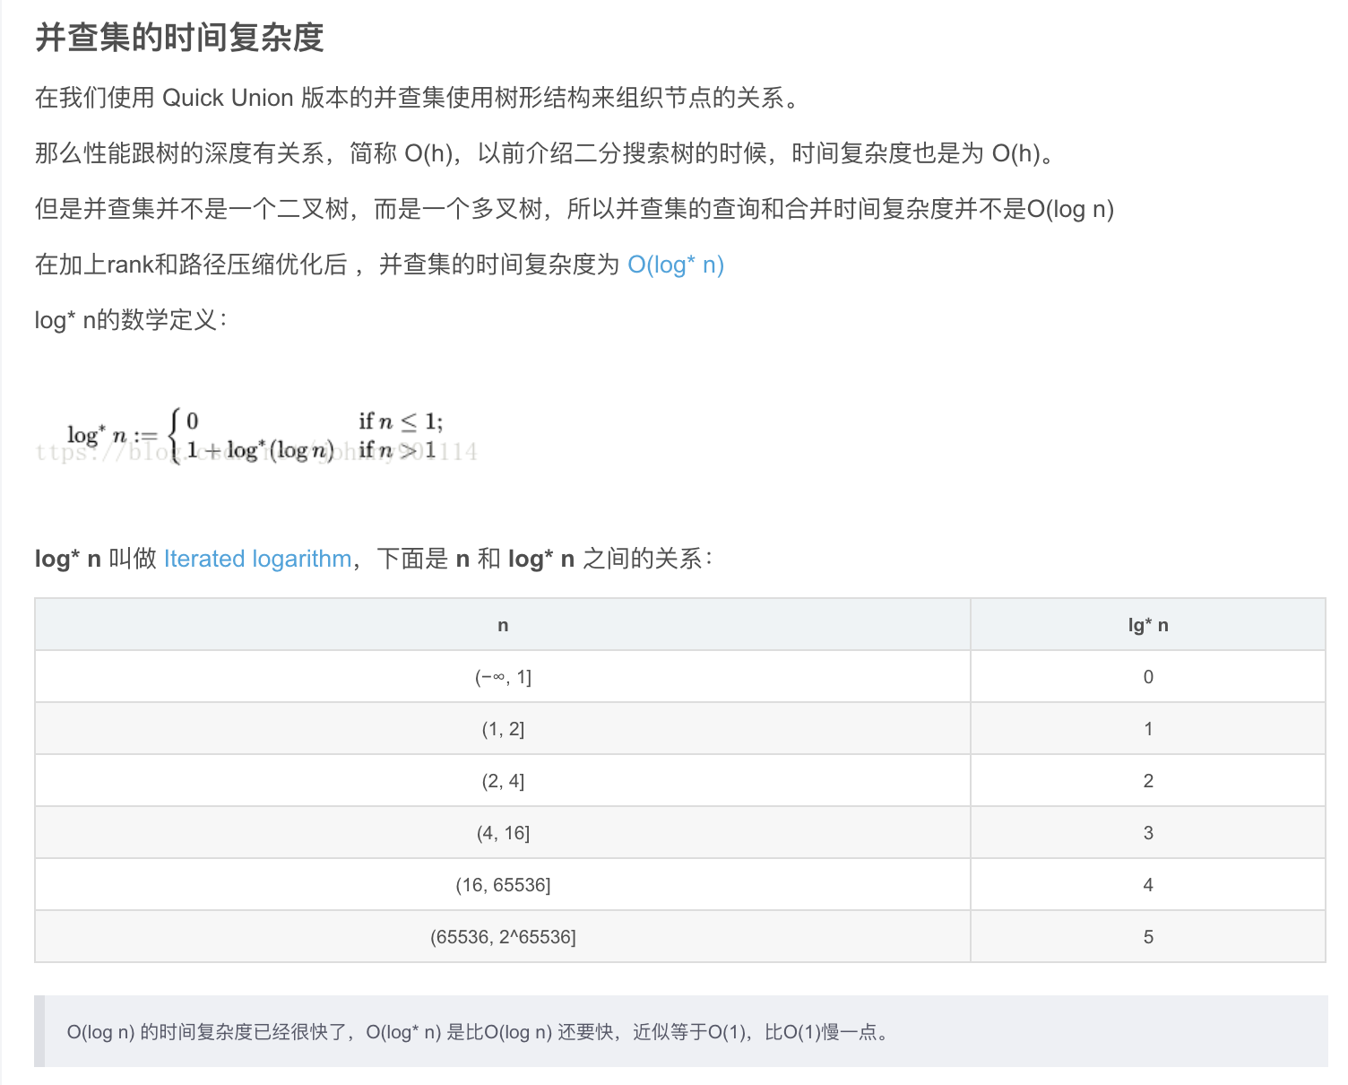
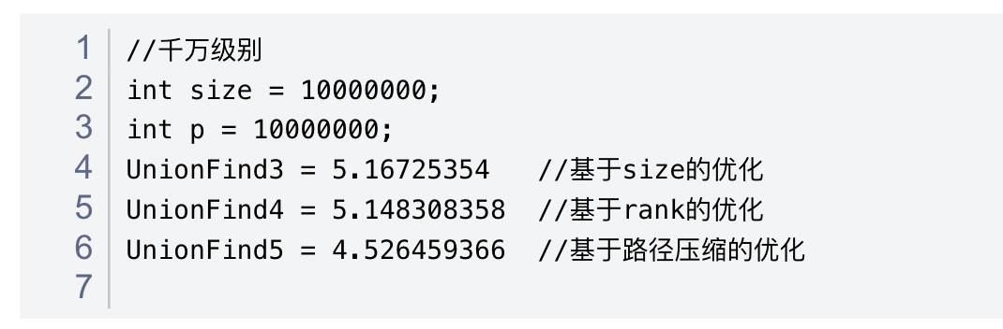
出处来自慕课网 liuyubobobo

Slide 23
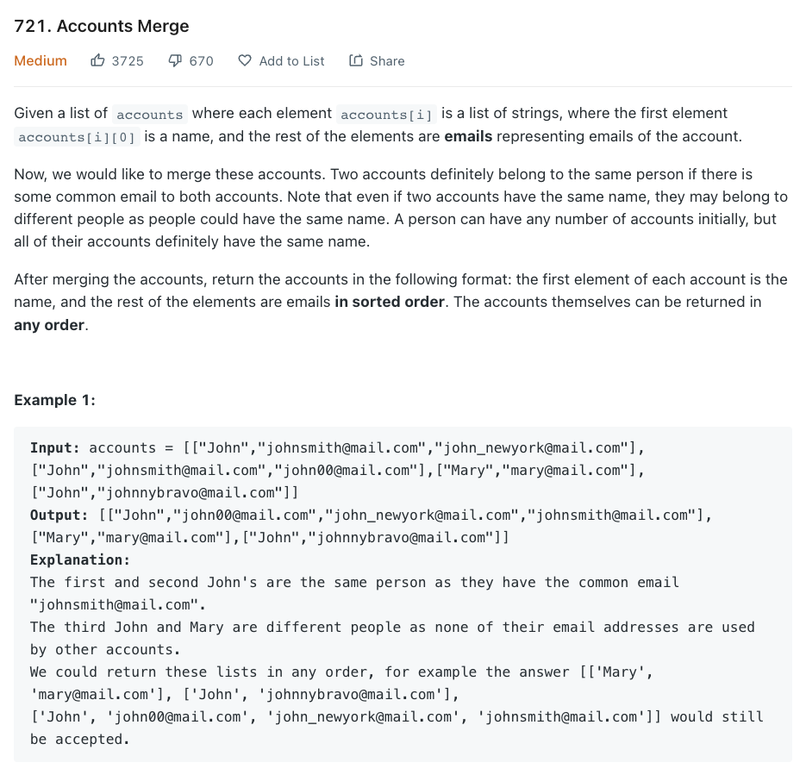
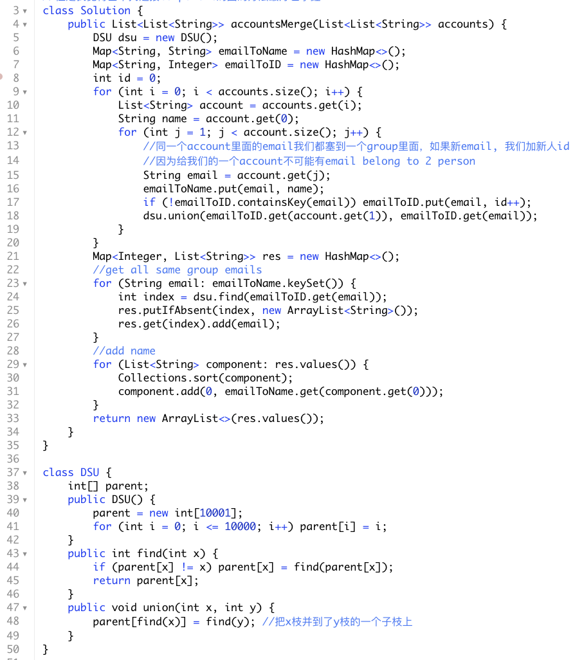
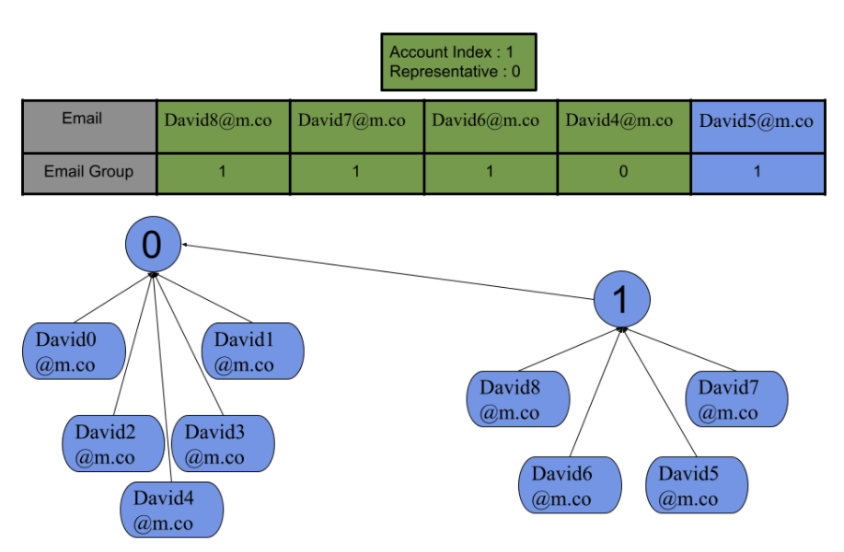

Slide 24
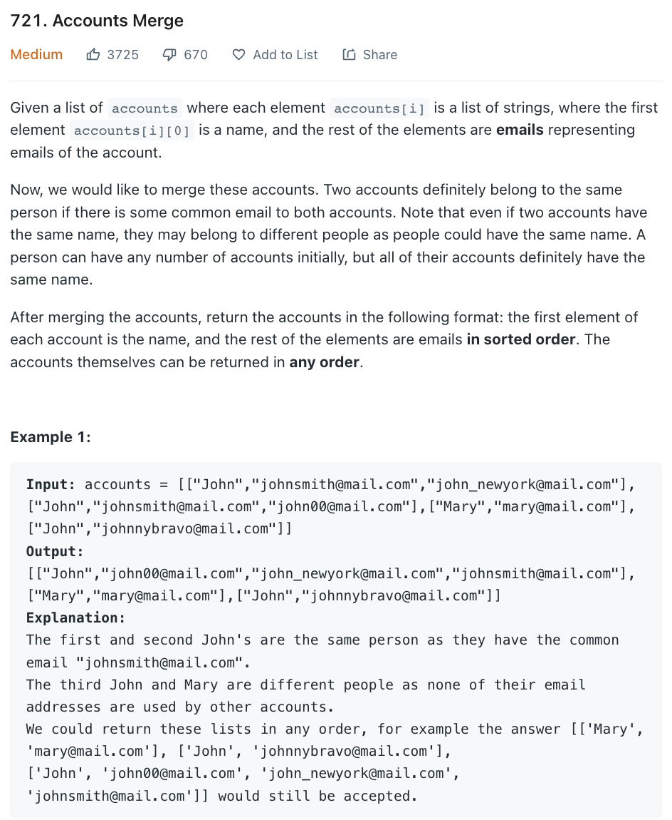
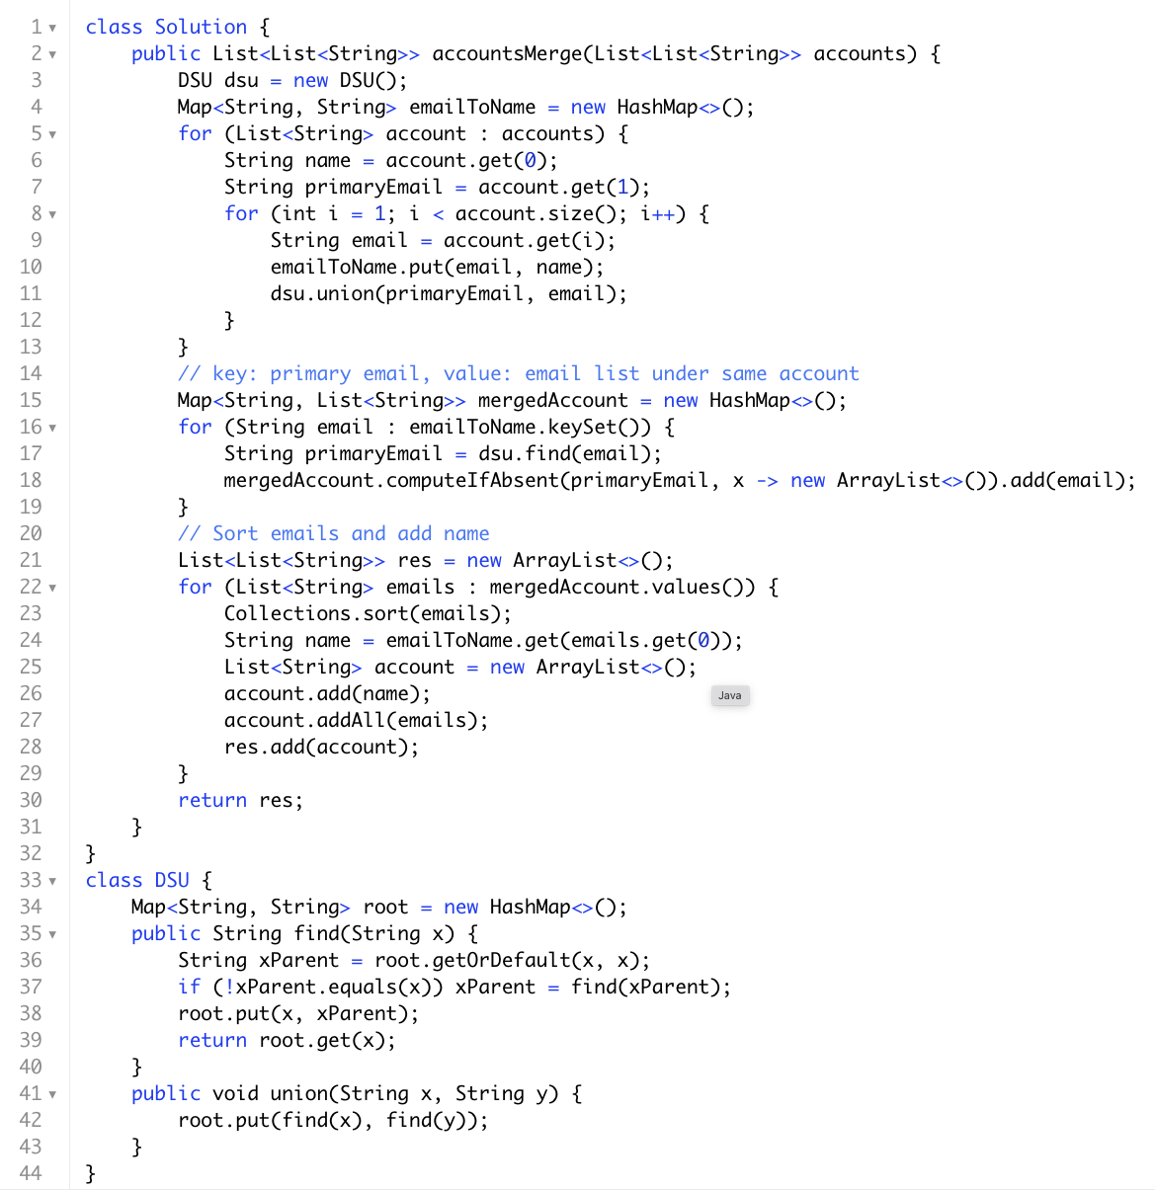
我们这里直接对email来进行mapping

Slide 25
Summary
reference: https://blog.csdn.net/johnny901114/article/details/80721436 时间复杂度
并查集 是一种树形的数据结构，用于处理不交集的合并(union)及查询(find)问题。
If m operations, either Union or Find, are applied to n elements, the total run time is O(m log*n), where log* is the iterated logarithm.
Slightly larger than O(m), it is Amortized O(m) 类似(not same)平均，实际为均摊
可以优化：
Path compression
Union by size
Union by rank
简易模板:

Slide 26


通讯页面
Bilibili https://space.bilibili.com/21630984
Youtube 搜索古城算法
https://www.youtube.com/c/古城算法
wechat 回复‘加群’可加群，还有周赛
谢谢大家的支持！请点赞订阅硬币
3000订阅会出一期dp总结篇
免费，不要钱，不卖课，不推销，不辅导，公开资料和视频，任何人和你说钱都是骗子！

